Slide 1
NEXTHIKES IT SOLUTIONS User Analytics in the T elecommunication Industry.
t4
BY:- NAMAN SHARMA.

Slide 2
PROJECT OVERVIEW
DATA ANALYSIS
Customer Overview
User Behaviour Insight
User Engagement
Engagement Clustering Insight
User Experience
Experience Score Summary
Satisfaction Score
Model Accuracy
Satisfaction Clustering
Top 10 Satisfied Customer
Agenda

Slide 3
Project Overview
To analyze TellCo’s customer data and uncover insights about user engagement, experience, and satisfaction, with a goal to evaluate the company's growth potential and acquisition viability.

Slide 4
Data Analysis
Data Overview
Total Entries: 150001
Total Features: 55
Data Types:
Numerical Features: 50
Categorical Features: 5
Target Variable: Satisfaction Score
Key Objective: is to provide data-driven insights into how customers interact with TellCo’s mobile services, identify areas of improvement, and support decision-making for better customer experience, engagement, and satisfaction.
Data Exploration
Missing Value /NAN Value Analysis
41 missing/nan values.
Fields: Session Info, Data Usage, RTT,
Retransmissions, Applications
Purpose: Analyze behavioral patterns of
mobile users

Slide 5
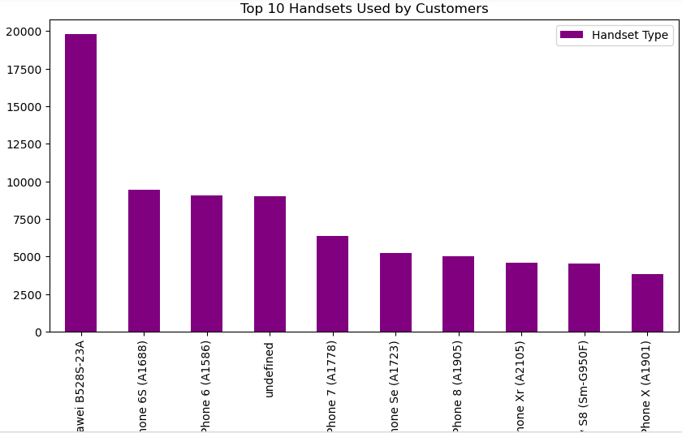
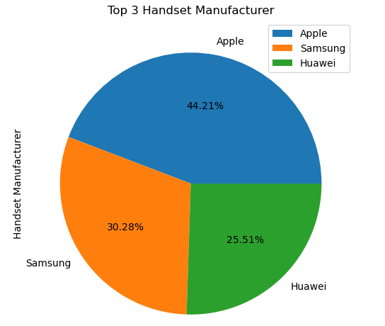
Customer Overview

Slide 6
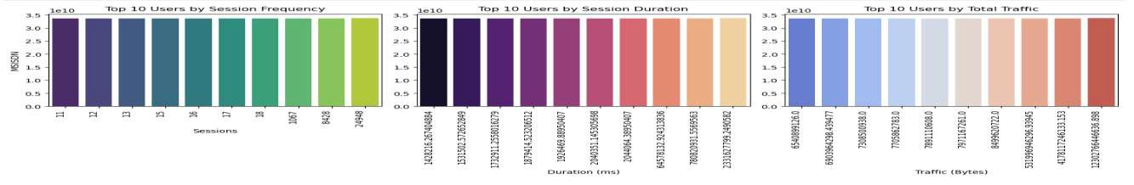
User Engagement
The most active users (e.g., user 12, 13, 24948...) have the highest number of sessions.
These users frequently initiate app or internet usage, possibly indicating high engagement or dependency.
Users like 1428218... and 535152... spend the most time per session.
These users may be engaged in long-form content (e.g., streaming, gaming, video calls).
Users like 6540899...,
6890594..., and 7708059...
consume the most data.
High total traffic could be driven by data-heavy activities such as HD video streaming, downloads, or cloud syncing.

Slide 7
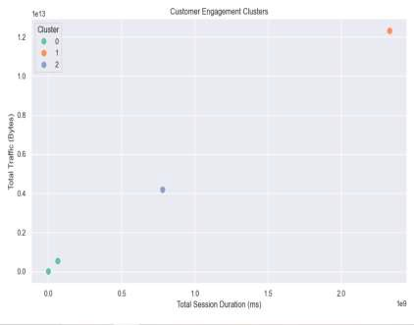
Engagement Clustering Insight
Key Insights:-
Three distinct customer segments (Clusters 0, 1, 2) are visible:
Cluster 1 (Orange, top right):
Highest traffic and longest session duration.
Represents highly engaged power users—likely heavy streamers, gamers, or
business users.
Cluster 0 (Green, bottom left):
Low traffic and short session duration.
Represents low-engagement users—likely casual or infrequent users.
Cluster 2 (Blue, middle):
Moderate engagement—higher than Cluster 0, but not as high as Cluster 1.
Could be regular users who use data for moderate tasks.

Slide 8
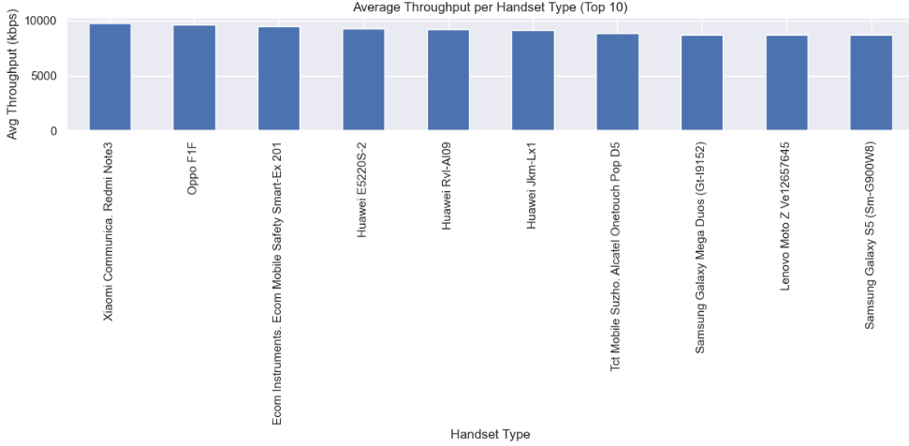
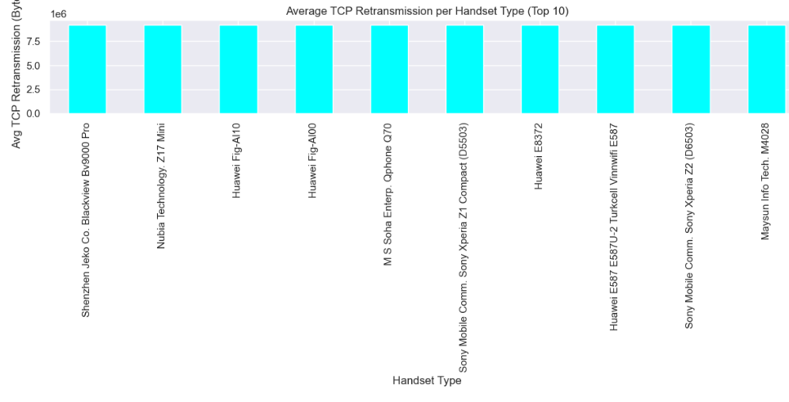
User Experience
Handsets at the top are likely better performing or used in stronger network areas, resulting in higher throughput (faster data transfer).
Low-throughput devices may face slower speeds or network issues.
Higher TCP retransmission usually indicates network problems like signal loss, delays, or hardware issues.
Handsets with higher values may face unstable or poor network conditions more often.

Slide 9
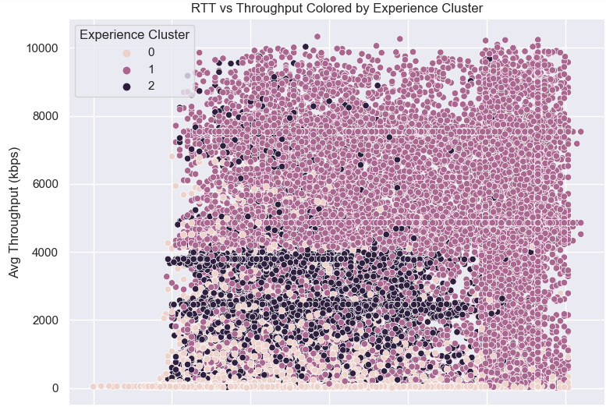
Experience Score Summary
Key insight
Cluster 0 (Pink): Exhibits higher RTT and lower throughput, indicating poor performance.
Cluster 1 (Purple): Displays moderate RTT and higher throughput, signifying better performance.
Cluster 2 (Black): Has the lowest RTT but moderate throughput, reflecting average performance.

Slide 10
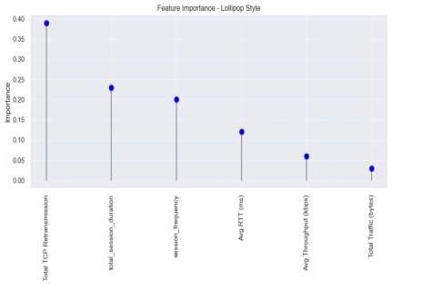
Satisfaction Score
Key Insight:-
Top Influencer:
Total TCP Retransmission is the most important feature by a significant margin. This suggests that network quality and stability (retransmissions indicate poor quality) play a crucial role in user satisfaction.
Moderate Contributors:
total_session_duration and session_frequency are the next important features. This implies that how long and how often users engage with the service contributes moderately to satisfaction
Lower Importance:
Avg RTT (ms) and Avg Throughput (kbps) have lesser influence. Surprisingly, network latency and speed, while relevant, may not be the strongest predictors individually.
Least Important:
Total Traffic (Bytes) is the least important feature. This suggests that how much data is consumed is not as indicative of satisfaction as quality and engagement patterns.

Slide 11
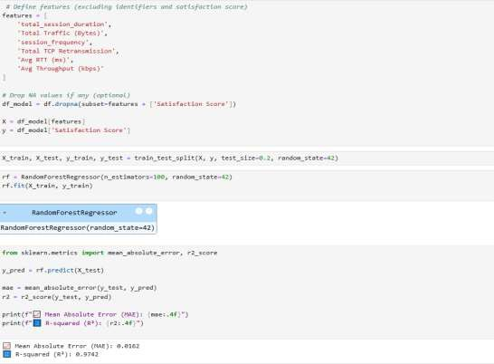
Model Accuracy
To predict User Satisfaction, we trained a Random Forest
Regressor using the following key features :-
Total Session Duration
Total Traffic (Bytes)
Session Frequency
Total TCP Retransmission
Average RTT (ms)
Average Throughput (kbps)
After splitting the data (80/20 train-test split), we evaluated the model using:-
MAE = 0.0612
R-squared (R²) = 0.9742
The very low MAE indicates that the model's predictions are very close to the actual satisfaction scores.
An R² score of 97.42% means the model explains a high proportion of the variance in user satisfaction, indicating excellent model performance.

Slide 12
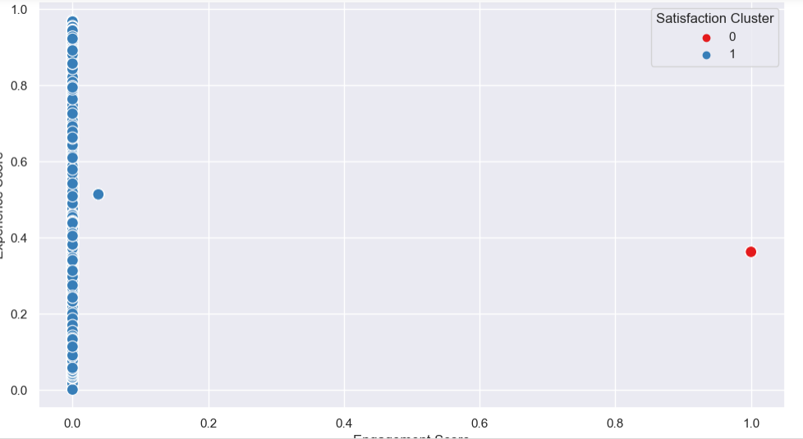
Satisfaction Clustering
Key Insight :-
Cluster 0 (Red Points) – very few users
These users have very low engagement scores (almost all are at 0).
Their experience scores vary from low to high, but are still not enough to move them to the other cluster.
This cluster likely represents unsatisfied or low-activity users.
Cluster 1 (Blue Points) - Majority of the users:
These users have high engagement scores and moderate to low
experience scores.
Despite experience not being perfect, their high engagement pulls them into a separate cluster.
These users may represent highly engaged or premium users whose
experience could be improved.
Severe Imbalance in Clusters:
Almost all users belong to Cluster 0, suggesting that most of the customer base is not actively engaging with the service.
Very few are in Cluster 1, indicating a potential issue with user engagement across the board.

Slide 13
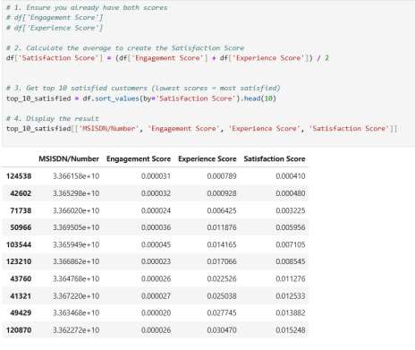
Top 10 Satisfied Customer
Satisfaction Score Interpretation:
The Satisfaction Score is calculated as the average of the
Engagement Score and Experience Score.
In this context, lower scores indicate higher satisfaction, which is an inverse scoring method (commonly used when lower metrics mean better service, e.g., fewer complaints, lower latency).
Top Performers:
The top 10 users listed have the lowest satisfaction scores, ranging
from approximately 0.000410 to 0.015248.
These users likely had smoother experiences with fewer issues, lower retransmissions, better throughput, or less time spent trying to engage with the network.
Best Performer:
MSISDN/Number 124538 has the lowest satisfaction score of 0.000410. meaning they had the best user experience
in terms of both engagement and experience matrics

Slide 14
Business Recommendation
Enhance Network Quality to Boost Satisfaction
Observation: Key features such as Avg RTT, TCP retransmissions, and Throughput are highly correlated with user satisfaction.
Recommendation:
Invest in improving network infrastructure, especially in areas with high latency or packet loss.
Prioritize network optimization to improve TCP performance and reduce round-trip times.
Personalize Engagement Based on User Behavior
Observation: Users with lower session durations and low usage frequency have lower engagement scores.
Recommendation:
Implement targeted offers based on usage patterns (e.g., top-up bonuses, data packs).
Launch personalized marketing campaigns for inactive or low-engagement users.
Segment and Reward Highly Satisfied Customers
Observation: The top 10 users with the lowest satisfaction scores are the most satisfied.
Recommendation:
Reward high-satisfaction users with exclusive loyalty perks.
Use this segment as a benchmark to identify what services/devices contribute to high satisfaction.

Slide 15
THANK YOU.

